Slide 1
Owned Exposed How I hack `Hacker` Facebook Account
Presented By El Rumi
@IDSECCONF 2011

Slide 2
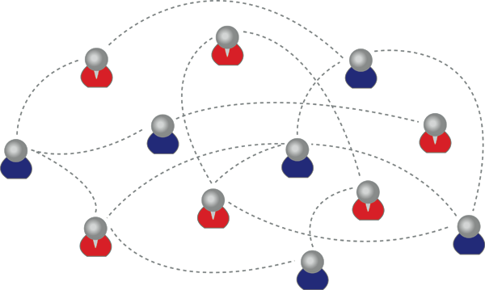
Social Network & Facebook
Social Network
Social Network is a social structure made up of individuals (or organizations) called "nodes", which are tied (connected) by one or more specific types of interdependency, such as friendship, kinship, common interest, financial exchange, dislike, sexual relationships, or relationships of beliefs, knowledge or prestige.
(source: http://en.wikipedia.org/wiki/Social_network)

Slide 3
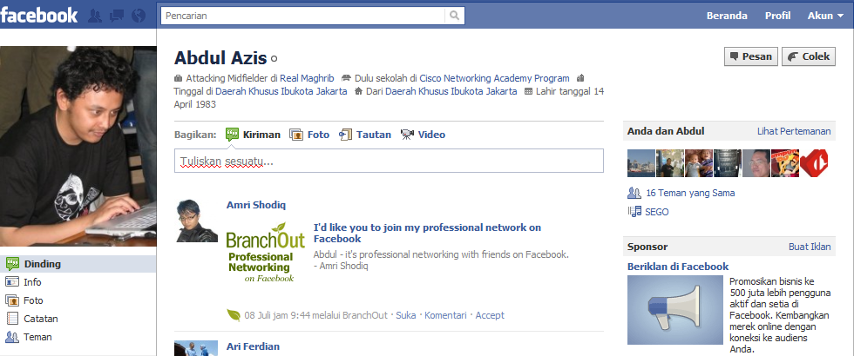
Social Network & Facebook
Facebook
A “social networking” site
Framework for information
Complex control of who can see what
Users have a “profile” with a picture* and other personal details as they wish, including “limited profile”
Based on “Networks”
Facebook creates a newsfeed based on what your “friends” are doing
(source: http://users.ox.ac.uk/~tony/facebook.ppt)

Slide 4
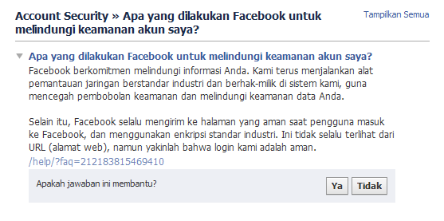
Facebook Account Security
?
(source: https://www.facebook.com/help/?faq=212183815469410)

Slide 5
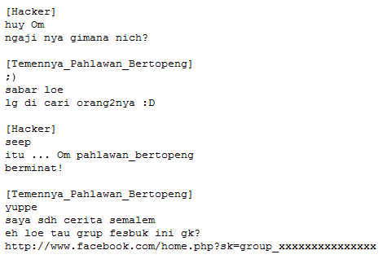
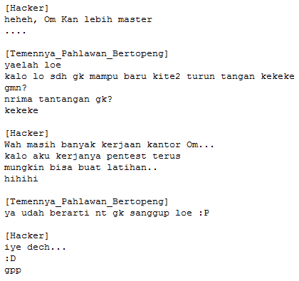
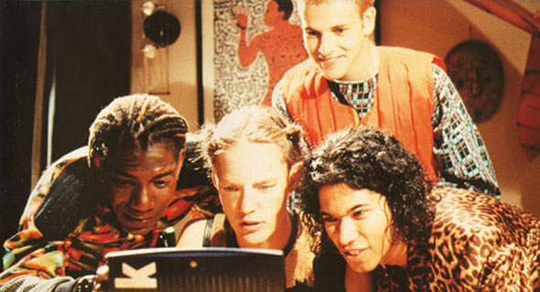
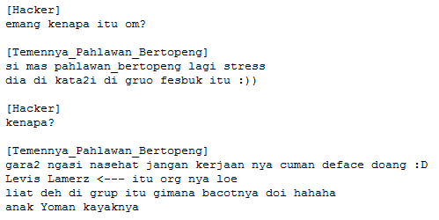
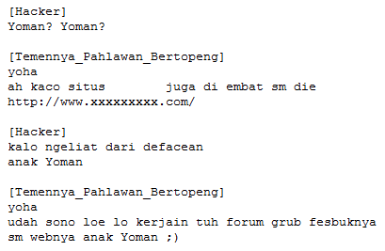
True Story....

Slide 6
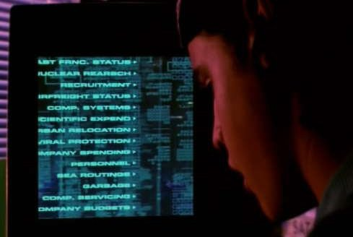
Let’s Start The Game

Slide 7
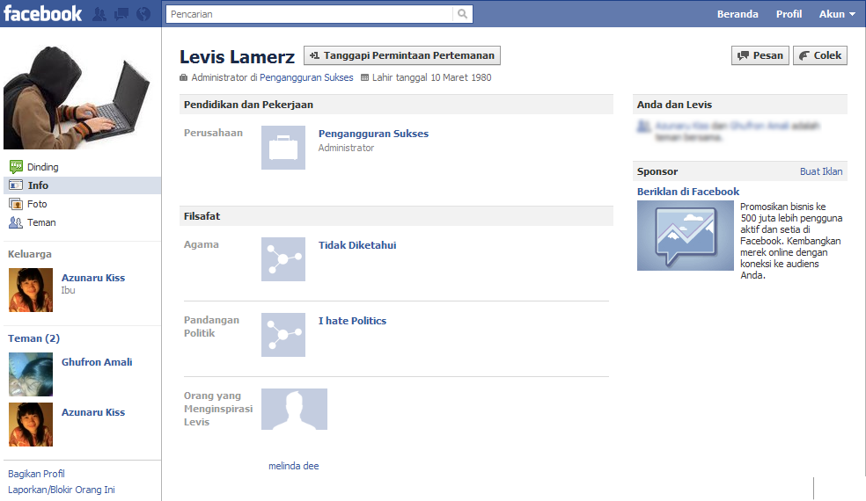
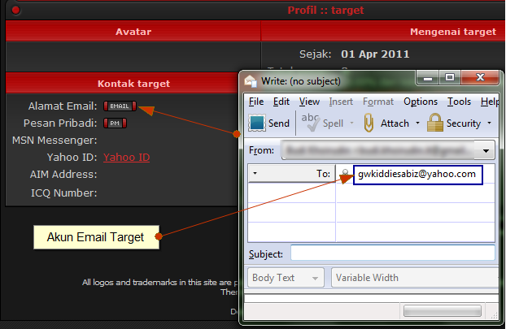
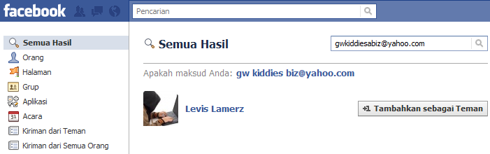
Proof of Concept! (Identification)

Slide 8
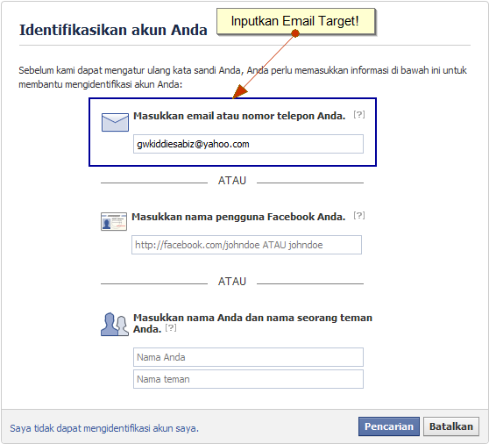
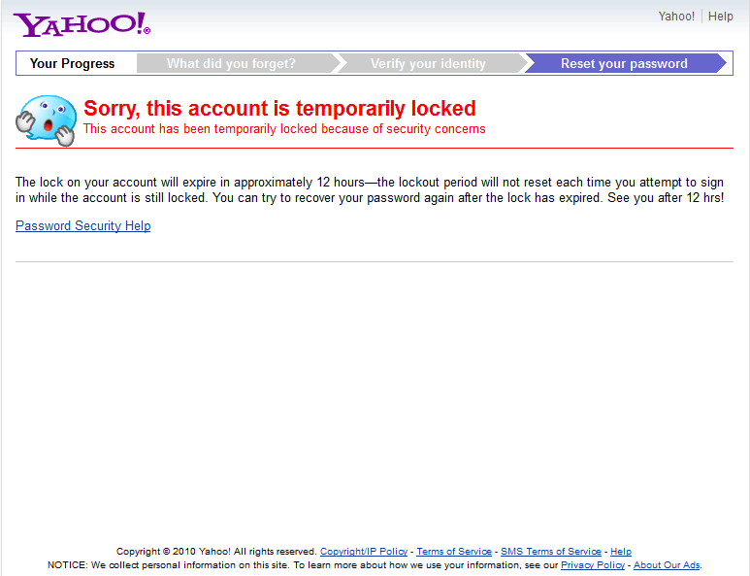
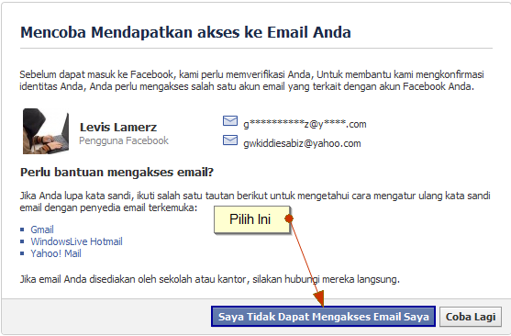
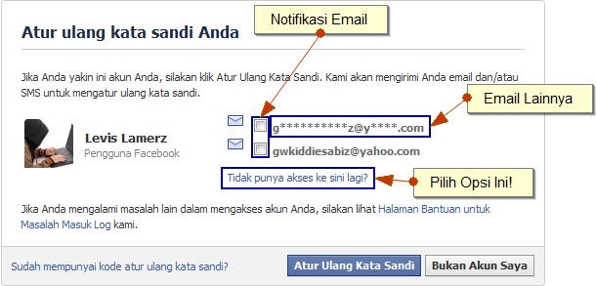
Proof of Concept! (Penetration)

Slide 9
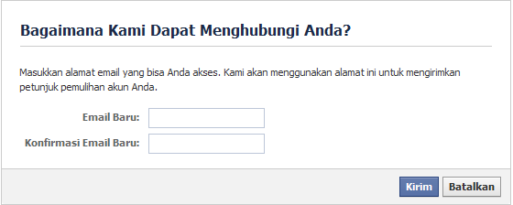
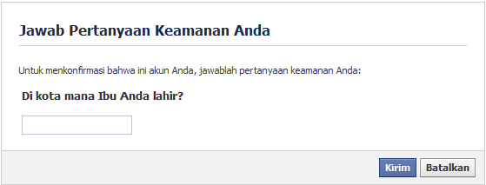
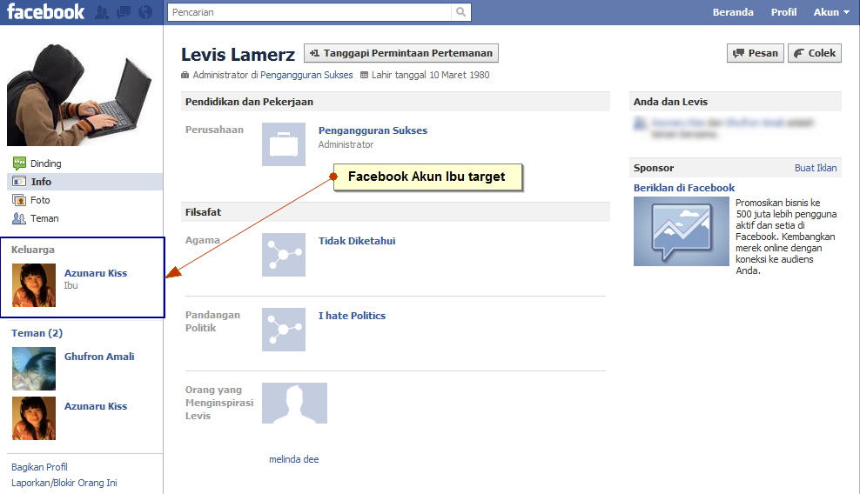
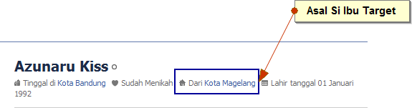
Proof of Concept! (Penetration)

Slide 10
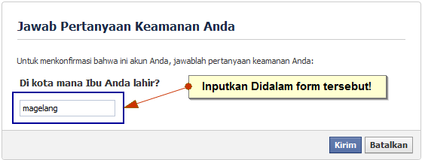
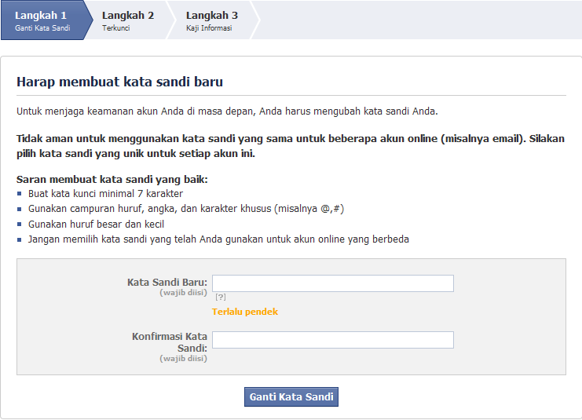
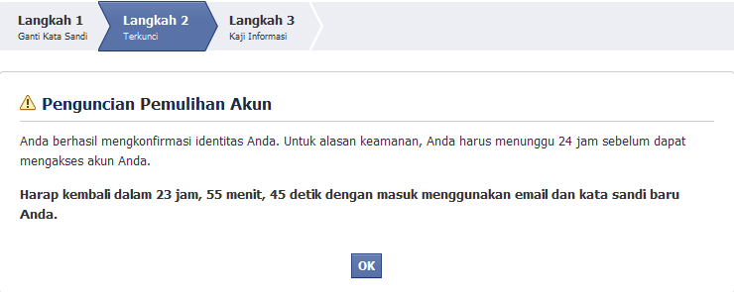
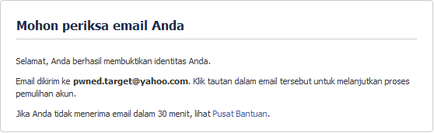
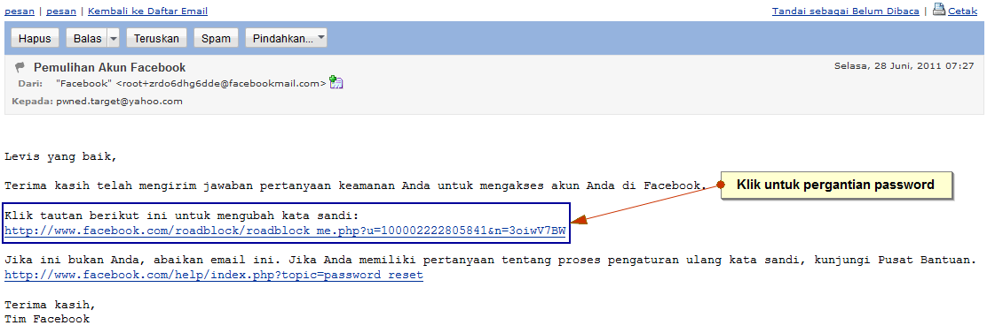
Proof of Concept! (Penetration)

Slide 11
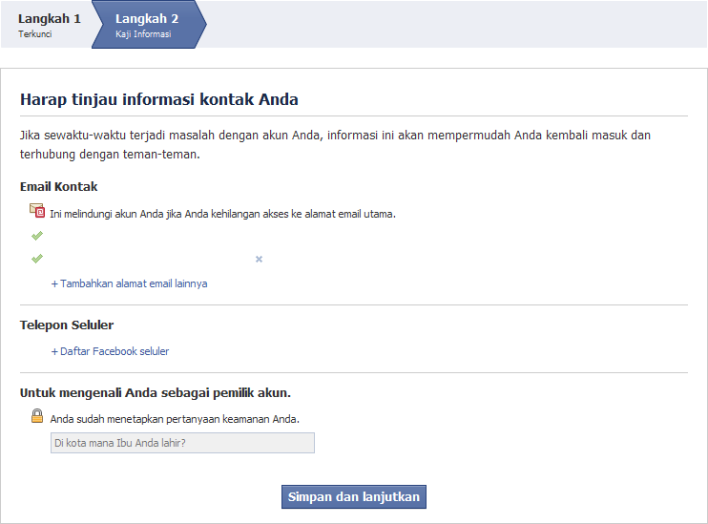
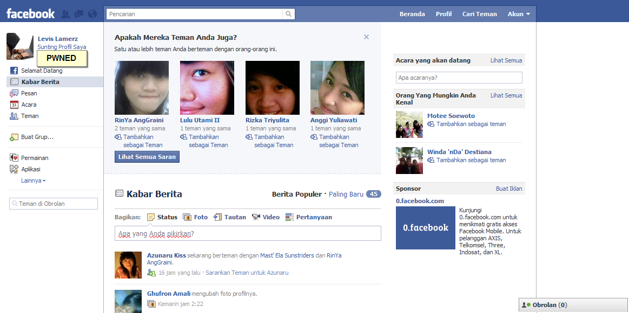
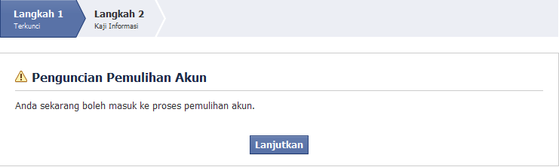
Proof of Concept! (Owned)
Take over

Slide 12
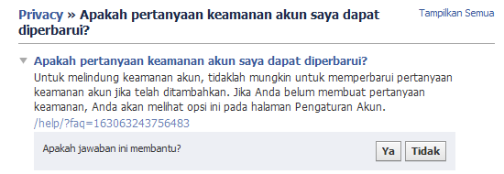
Can We Prevent This?
Change Security Question?
(source: https://www.facebook.com/help/?faq=163063243756483)

Slide 13
So?
Hide Your Sensitive Data From Public.
Hide Your Email From Public.
Make Security Question :
With Different Thing Answer But Easy To Remember.
With Right Answer But Encrypted (md5, sha1, rot13, etc)

Slide 14
Video Demo

Slide 15
Heil Indonesian Hacker’s
“If any skiddy community gets too big, we shut them down. If any lamer causes too much trouble, we shut them down. If any group keeps fucking stuff up, we stop them.”
-Elz (Kecoak Elektronik)-
(source: http://kecoak.org/log/2010/12/25/owned-and-exposed-pwned-some-skiddy/)

